Slide 1
Sonar Analysis
Assignment

Slide 2
What is SonarQube
SonarQube is an open-source platform developed by SonarSource for continuous inspection of code quality to perform automatic reviews with static analysis of code to detect bugs and code smells on 29 programming languages. SonarQube offers reports on duplicated code, coding standards, unit tests, code coverage, code complexity, comments, bugs, and security recommendations.

Slide 3
What is Sonar Analysis ?
Sonar analysis can help improve the quality of an application's code, which can lead to:
Increased revenue from conversions
Greater brand awareness and recognition
Higher user retention and engagement levels
Reduced technical debt
Increased lifetime of the application

Slide 4
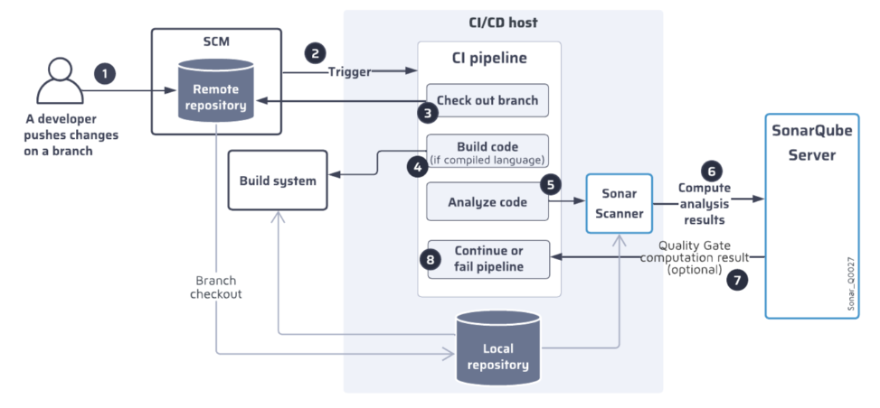
Integration into your CI pipeline

Slide 5
Code analysis with the SonarScanner
The SonarScanner performs the source code analysis. This stand-alone program runs on the CI/CD host and sends the analysis results to SonarQube Server, which computes them, calculates the quality gate, and generates reports.
To perform the analysis, the SonarScanner uses the language analyzers that it downloads from SonarQube Server at installation.

Slide 6
Analysis process
Essentially, the main steps of the analysis process are:
Your build or CI pipeline starts the SonarScanner.
The SonarScanner scans the local repository and determines the files to be analyzed according to the configured analysis scope.
The scanner sends an analysis request to the respective language analyzer which retrieves the files to be analyzed from the file system and analyzes them according to the configured quality profile.
he analyzer sends the analysis results (quality measures and issues) to the scanner which forwards them to SonarQube Server in the form of a report.
SonarQube Server computes the analysis results asynchronously to perform the following:
It identifies the new issues according to the configured New Code definition and raises them in both the new code and the overall code (It uploads the code as part of the analysis and shows users the code that it raised issues on. Unanalyzed changes in the code are not visible.).
It computes the quality gate.
It generates reports.

Slide 7
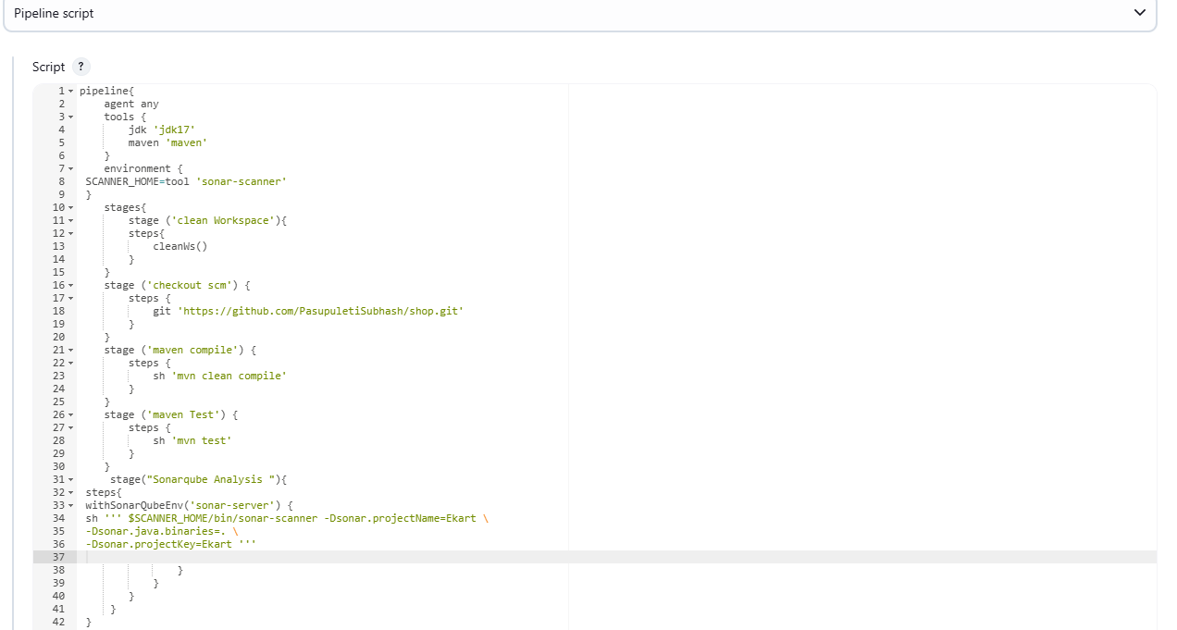
Pipeline For Sonar Analysis

Slide 8
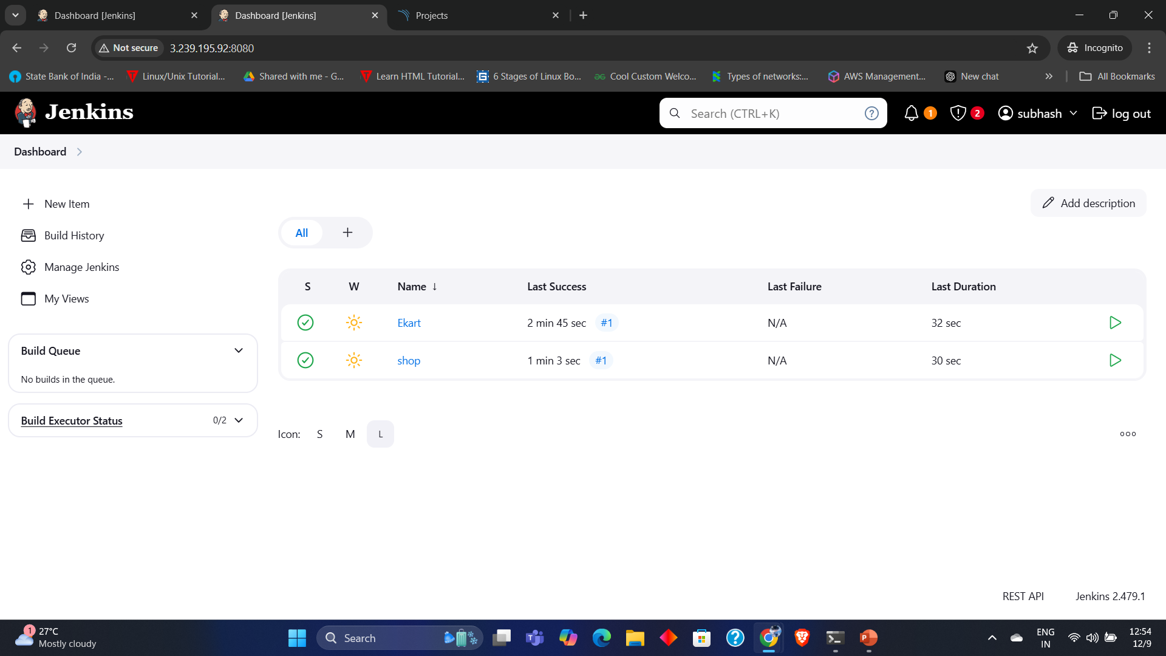
Jenkins Dashboard

Slide 9
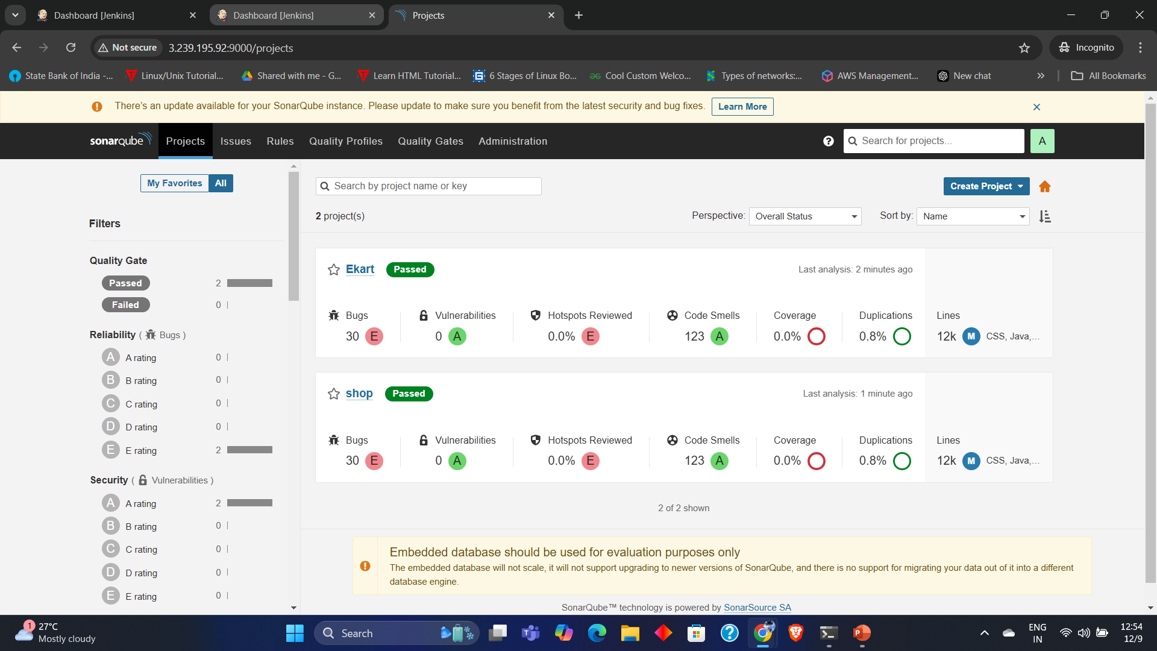
Sonar Analysis Projects

